Slide 1
Flight Delay & Cancellation Analysis Project
PREPARED BY MALINI ROY CHOUDHURY

Slide 2
Problem Statement and Objective
Problem Statement:
Airlines were facing a surge in customer complaints due to frequent flight delays and cancellations. Leadership lacked visibility into the root causes, with unclear metrics caused by missing or inconsistent data in departure times and delay records. Without structured analysis, it was difficult to identify whether delays were concentrated at specific airports, routes, or times of day, and cancellation trends by airline remained hidden. This created operational inefficiencies and negatively impacted customer satisfaction.
Objective:
Clean and validate flight data using SQL to ensure accuracy in delay and cancellation metrics.
Analyze patterns and root causes of delays and cancellations by airline, airport, route, and time of day.
Build interactive Power BI dashboards with KPIs and matrices to provide actionable insights, reduce complaints, and improve operational performance.

Slide 3
Dataset Overview
Sources :CSV
Size: (500, 9)
Timeframe: 2024-01-01 to 2024-31-06
Tools : PostgreSQL and Power BI
Key Variables:
flight_id : flight record ID
airline : Airline name
flight_number: Flight number
origin :Origin airport
destination : Destination airport
scheduled_departure : Scheduled departure time
actual_departure : Actual departure time
delay_minutes : Delay in minutes
canceled : Whether flight was canceled

Slide 4
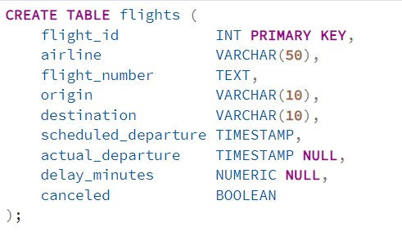
Dataset
Sample Schema (Table: flights)
Column | Type | Description
flight_id | INT | Unique flight record ID
airline | TEXT | Airline name
flight_number | TEXT | Flight number
origin | TEXT | Origin airport
destination | TEXT | Destination airport
scheduled_departure | TIMESTAMP | Scheduled departure time
actual_departure | TIMESTAMP (NULL) | Actual departure time
delay_minutes | INT (NULL) | Delay in minutes
canceled | BOOLEAN (0 or 1) | Whether flight was canceled

Slide 5
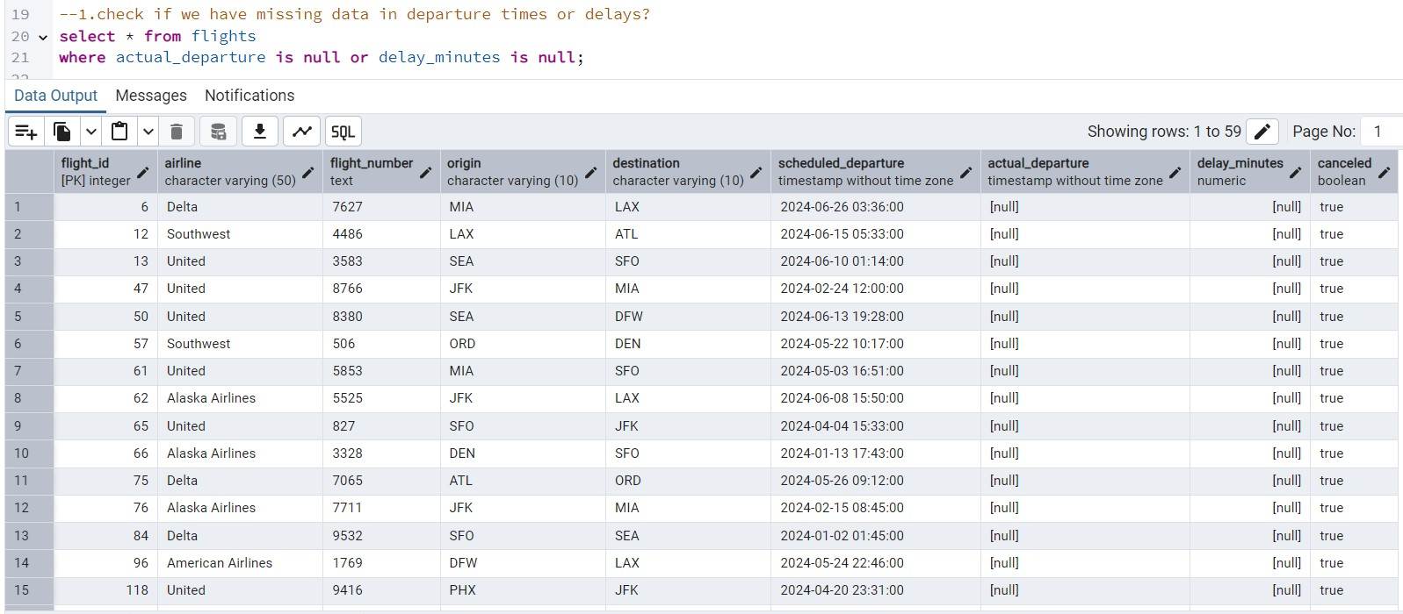
Use of IS NULL
, WHERE
, basic filtering.
The query identified flights with missing actual_departure or delay_minutes values. All such records were canceled, highlighting data gaps that could distort delay metrics and needed cleaning before analysis.

Slide 6
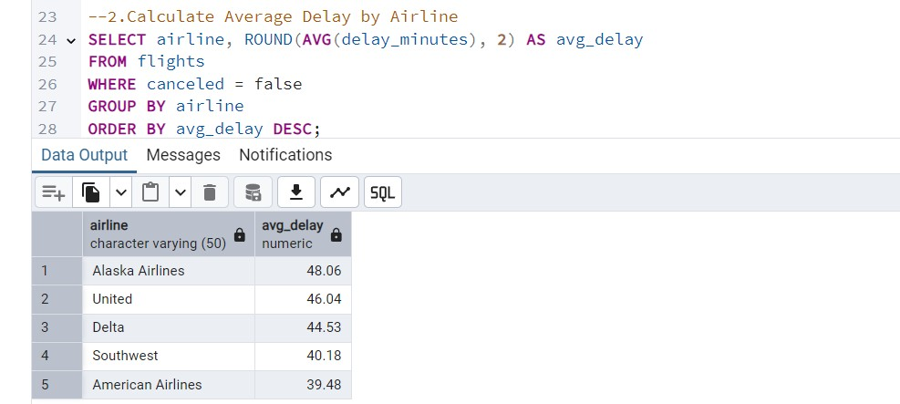
Use of AVG(), GROUP BY, filtering with WHERE
The query calculated average delays for non‑canceled flights. Alaska Airlines showed the highest average delay (48 mins), while American Airlines had the lowest (39 mins), revealing performance differences across carriers.

Slide 7
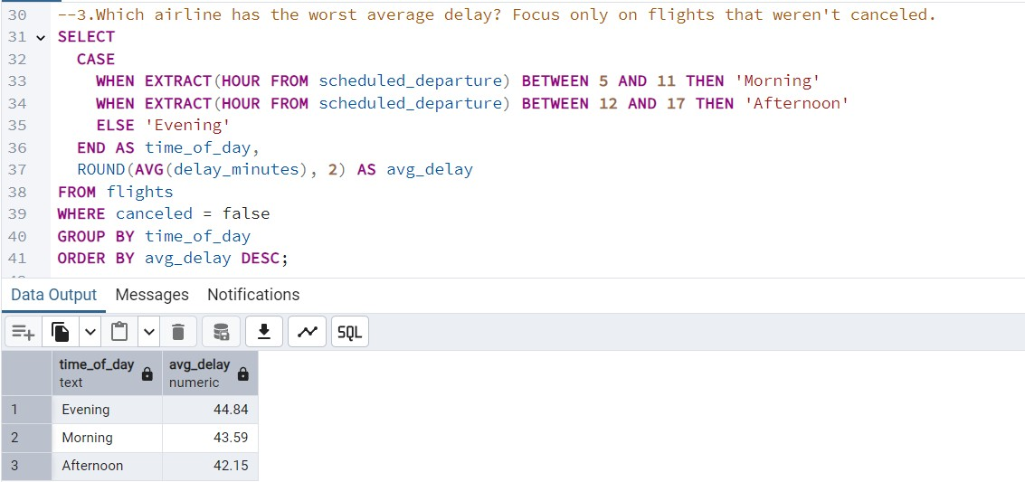
Use of EXTRACT(HOUR), CASE WHEN, grouping
The query grouped delays by morning, afternoon, and evening departures. Results showed evening flights had the worst delays (44.8 mins), followed by morning and afternoon, indicating time‑based operational bottlenecks.

Slide 8
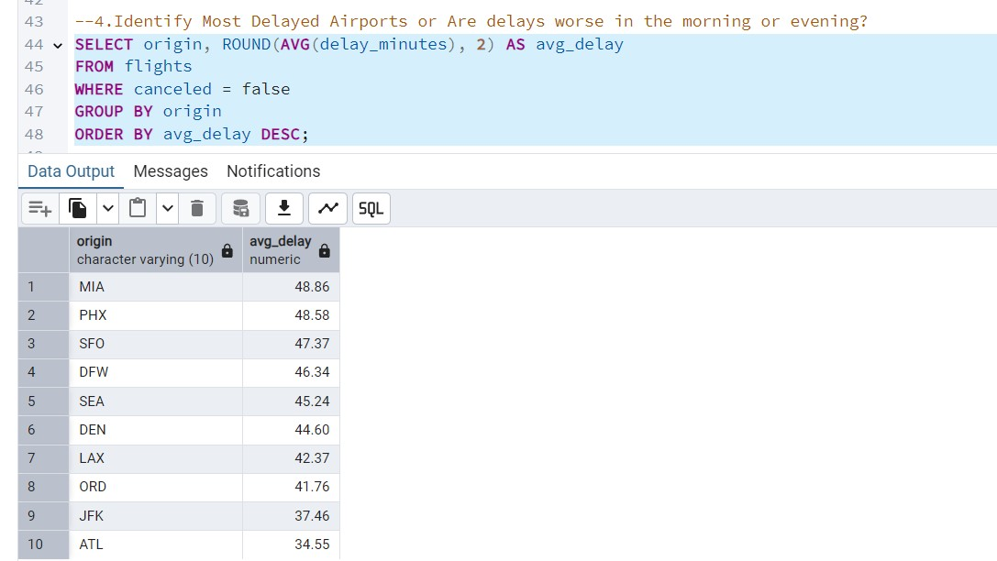
The query ranked airports by average delay times. Miami (MIA) and Phoenix (PHX) showed the highest delays (~49 mins), while Atlanta (ATL) had the lowest (~35 mins), highlighting airport‑specific performance issues.

Slide 9
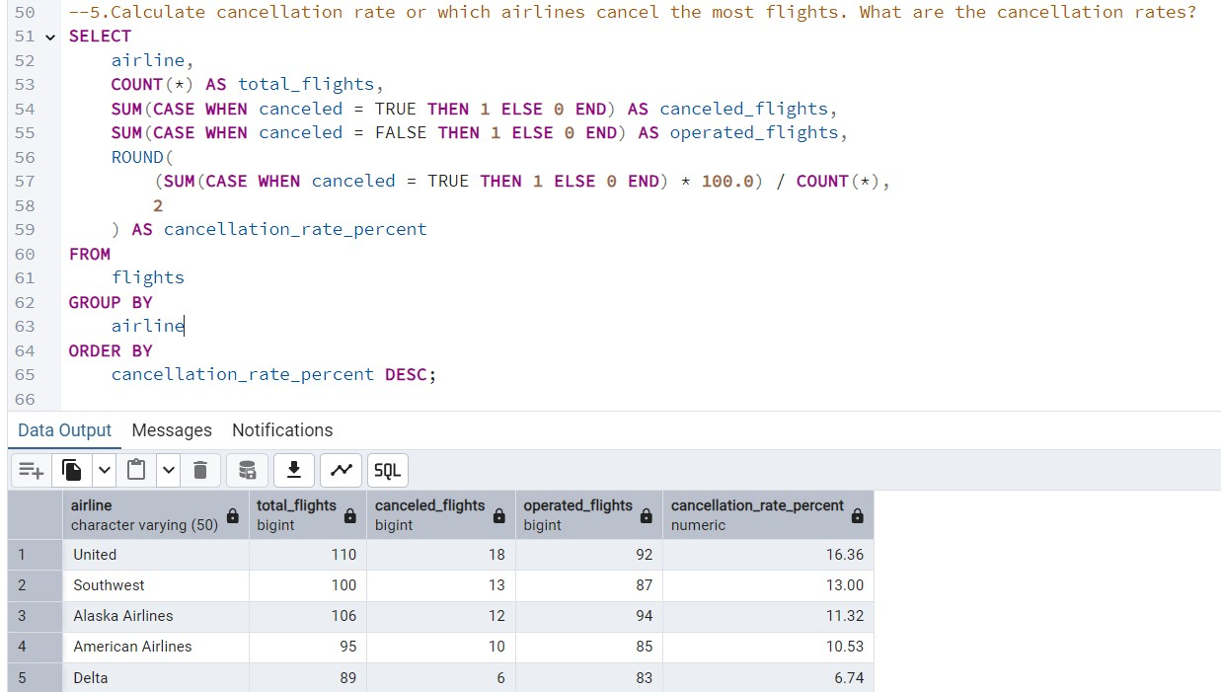
The query calculated cancellation rates per airline. United had the highest cancellation rate (16.36%), while Delta had the lowest (6.74%), showing clear differences in reliability across carriers.

Slide 10
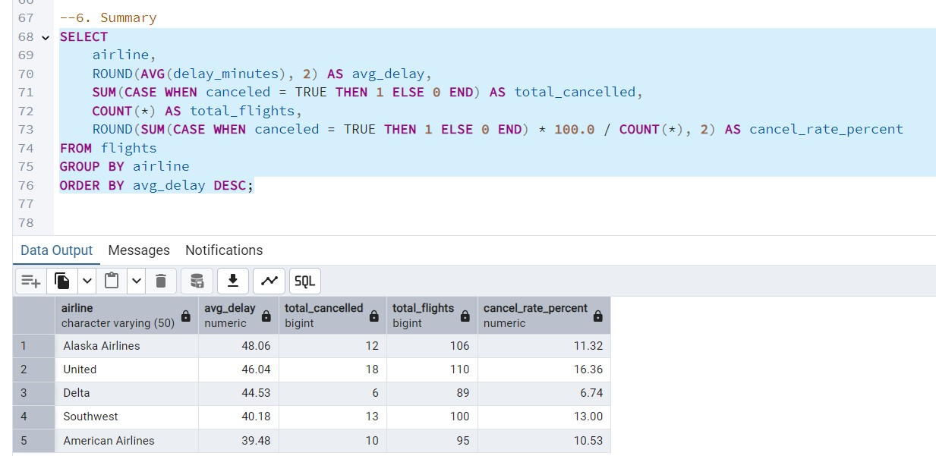
The summary combined average delays and cancellation rates. Alaska Airlines had the worst delays (48 mins), while United had both high delays and the highest cancellation rate, making them key focus areas for improvement.

Slide 11
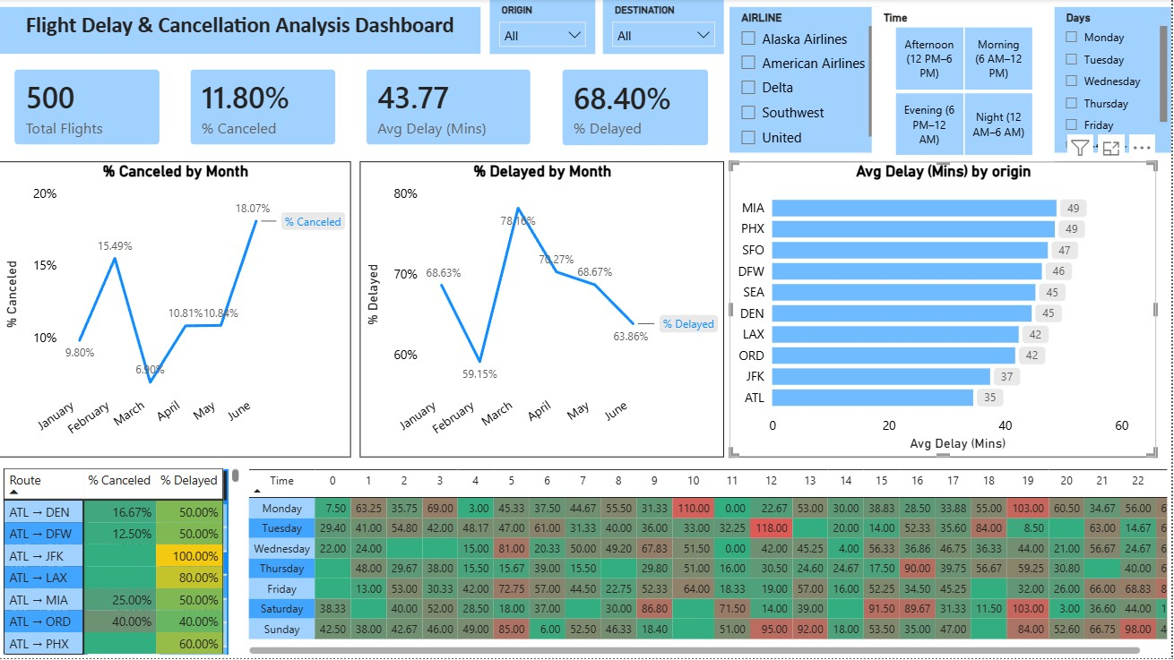

Slide 12
Dashboard Highlights
Built an automated Power BI dashboard for Flight Delay & Cancellation Analysis with
4 KPIs:
Total Flights = 500,
% Canceled=11.80%,
Avg Delay (Minutes)=43.77,
% Delayed=68.40%.
Line chart shows % Canceled by Month → June recorded the highest cancellation rate.
Line chart shows % Delayed by Month → March had the highest delay percentage.
Bar chart highlights MIA airport with the highest average delay (49 minutes).
Table matrix displays Route‑wise % Canceled and % Delayed, surfacing problem routes (e.g., ATL → JFK).
Heatmap matrix shows Avg Delay by Hour (0–23) and Day of Week, revealing spikes between 3–6 PM.
Interactive slicers added for Airline, Origin, Destination, Time, and Day filters to drill down insights.

Slide 13
Functional Uses (DAX formula)
Calculated Columns:
Departure Hour = HOUR('flights'[scheduled_departure])
Day of Week = FORMAT('flights'[scheduled_departure], "dddd")
Route = 'flights'[origin] & " → " & 'flights'[destination]
Is Delayed = IF('flights'[delay_minutes] > 15, "Yes", "No")
Key Measures:
Total Flights = COUNTROWS('flights')
Avg Delay (Minutes) = AVERAGE('flights'[delay_minutes])
Total Cancellations = CALCULATE([Total Flights], 'flights'[canceled] = 1)
% Canceled = DIVIDE([Total Cancellations], [Total Flights])
Delayed Flights = CALCULATE([Total Flights], 'flights'[Is_Delayed] = "Yes")
% Delayed = DIVIDE([Delayed Flights], [Total Flights])

Slide 14
Executive Summary
Purpose: To identify root causes of flight delays and cancellations and provide actionable insights.
Scope: Analysis of 500 flights across multiple airlines, routes, and time periods.
Key KPIs:
Total Flights: 500
% Canceled: 11.8%
Avg Delay: 43.8 minutes
% Delayed: 68.4%
Highlights:
June recorded the highest cancellation rate.
March showed the highest delay percentage.
Miami (MIA) had the longest average delays.
Evening flights (3–6 PM) experienced the worst delays.
Route ATL → JFK had the highest cancellation rate.

Slide 15
Recommendations
Focus on Evening Flights (3–6 PM): Address operational bottlenecks during peak delay hours with better scheduling and resource allocation.
Improve Route Reliability: Prioritize corrective measures for high‑risk routes such as ATL → JFK, which showed the highest cancellation rate.
Airport‑Specific Action Plans: Target airports with consistently high delays (MIA, PHX, SFO) by reviewing ground operations and turnaround processes.
Airline Performance Monitoring: Engage with carriers like United, which had the highest cancellation rate, to improve reliability and customer satisfaction.
Continuous Dashboard Use: Leverage the Power BI dashboard for ongoing monitoring, enabling leadership to track KPIs and act on emerging trends in real time.

